Slide 1
Structural Equation Modeling
Psychology Brown Bag
26 November 2014

Slide 2
Introduction to SEM
Most tests can be modeled as a SEM.

Slide 3
Basic Terminology
Standardized Variable: Variable whose mean is zero and variance is one
Latent Variable: Unmeasured variable in model. Sometimes called factor.
Exogenous Variable: Variable that is not caused by another in the model. (Independent variables)
Endogenous Variable: Variable that is caused by another in the model. Can still cause other endogenous variables! (Pseudo-dependent variable)

Slide 4
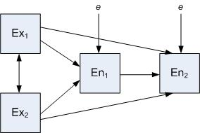
Basic Terminology

Slide 5
Basic Terminology
Structural Coefficient: Similar to regression coefficient; measure of the amount of change in the endogenous variable given a one unit change in the causal variable and no change in any other variable
Hierarchical Model: Model with no feedback loops (one-direction).

Slide 6
Model Identificiation
Identification: A model with a unique solution for all of the model’s parameters.
Number of known values must equal or exceed the number of free parameters
X + 2 = 4 (identified)
X + Y = 4 (not-identified)

Slide 7
Model Identification
Known Values: the number of covariances present in the model
K(k+1)/2 where k = number of variables (all types)
Notes:
4(5)/2 = 10

Slide 8
Model Identification
Free Parameters: all estimated paths, covariances, correlations, variances of exogenous variables, disturbances of endogenous variables
Notes:
5 paths, 1 correlation, 2 disturbances, 2 variances (10)

Slide 9
Model Identification
Constraints: setting a parameter (structural coeffiecent, mean, variance) equal to some other function.
Equal paths
When two things are constrained to equality; count as one free parameter.

Slide 10
Model Identification
Degrees of Freedom of a Model: Number of knowns minus the number of free parameters

Slide 11
Model Identification
Just-Identified: Zero degrees of freedom (saturated model)
Under-Identified: Negative degrees of freedom. Cannot accurately compute.
Over-Identified: Positive degrees of freedom.
Model Fit: Ability of an over-identified model to reproduce the underlying correlation or covariance matrix of the variables
How much of the data variance does the model explain.

Slide 12
Parameter Identification
Just because the overall model is identified does not mean that the individual parameters are identified.
X -2 = 4
X + 2 = 4

Slide 13
Model Identification

Slide 14
Steps of SEM
1. Specification
2. Identification
3. Estimation
4. Model Fit

Slide 15
Model Fit
Sample Size to detect model fit
General Rules of Thumb:
5 participants for every 1 free parameter (Bentler & Chou, 1987)
Power Analysis
Many calculators avaialble; raw equation is available in Sattora and Saris (1985)

Slide 16
Model Fit
Over-identified models may be wrong; need to be able to detect how wrong.
Chi-squared test of model fit is the most traditional; good for 75-200 cases
Tests the difference between the data and the model

Slide 17
Model Fit
Chi-squared test of model fit
Null hypothesis: There is no statistically significant difference between the model and the underlying data.
Alternative hypothesis: There is a statistically significant difference between the model and the underlying data.
Want to fail to reject the null
Otherwise, too much difference between the data the model produces and the sample data.

Slide 18
Model Fit
Other Fit Indices
Incremental Fit Index:
Worst Possible Model – Current Model
Worst Possible Model – Best Possible Model

Slide 19
Model Fit
Other Fit Indices
Absolute Fit Index
Best fitting model = zero; how far is the model from zero?
Measures of “badness”

Slide 20
Model Fit
Comparative Fit Index
Used to compare the fit of one model to the fit of a second model
Often also called absolute fit index

Slide 21
Model Fit
Factors that influence fit
Number of Variables: move variables tend to have relatively poor fit
Ongoing mathematical debate as to why
Overall Complexity
More complex models have relatively poor fit
Sample Size
Variation between models with more variables or more complexity is less with larger sample sizes
Normality
Non-normal data (high kurtosis especially) inflates chi-squared and absolute measures of fit

Slide 22
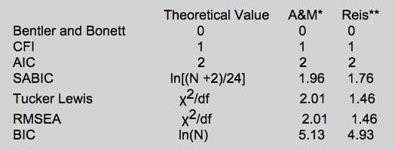
Model Fit
http://davidakenny.net/cm/fit.htm
Notes:
TV = how much chi squared is supposed to have to change to influence measurements of model fit

Slide 23
Examples

Slide 24
Further Info
SEMNET
Website (Model Fit)
Books
Articles

